Slide 1
CSE/T/324A Computer Networks Topic 5- Network Layer Logical Addressing
Dr. Sarbani Roy
sarbani.roy@gmail.com
Office: CC-5-7
Cell: 9051639328

Slide 2
Network Layer
The network layer is concerned with getting packets from the source all the way to the destination.
The packets may require to make many hops at the intermediate routers while reaching the destination. This is the lowest layer that deals with end to end transmission.
In order to achieve its goals, the network layer must know about the topology of the communication network.
It must also take care to choose routes to avoid overloading of some of the communication lines while leaving others idle.
The network layer-transport layer interface frequently is the interface between the carrier and the customer, that is the boundary of the subnet. The functions of this layer include : Routing, Inter- networking, Congestion Control

Slide 3
Overview of Routing, Inter-Networking and Congestion

Slide 4
Routing
The process of transferring packets received from the Data Link Layer of the source network to the Data Link Layer of the correct destination network is called routing.
Involves decision making at each intermediate node on where to send the packet next so that it eventually reaches its destination.
The node which makes this choice is called a router.
For routing we require some mode of addressing which is recognized by the Network Layer. This addressing is different from the MAC layer addressing.

Slide 5
Addressing Schemes
IP addresses are of 4 bytes and consist of :
The network address, followed by
The host address
The first part identifies a network on which the host resides and the second part identifies the particular host on the given network.
Some nodes which have more than one interface to a network must be assigned separate internet addresses for each interface.
This multi-layer addressing makes it easier to find and deliver data to the destination.
A fixed size for each of these would lead to wastage or under-usage that is either there will be too many network addresses and few hosts in each (which causes problems for routers who route based on the network address) or there will be very few network addresses and lots of hosts (which will be a waste for small network requirements). Thus, we do away with any notion of fixed sizes for the network and host addresses.

Slide 6
Addresses
When surfing the web, web site addresses can be represented in two ways.
www.google.com —A uniform resource locator or URL.
74.125.224.72—An IP address.
The mnemonic name, google.com, is called a domain name, and is easier to remember than the numeric IP address. Whenever a domain name is entered into a web browser, the browser searches a database called a Domain Name Service that tells it how to convert the mnemonic name into the corresponding IP address.

Slide 7
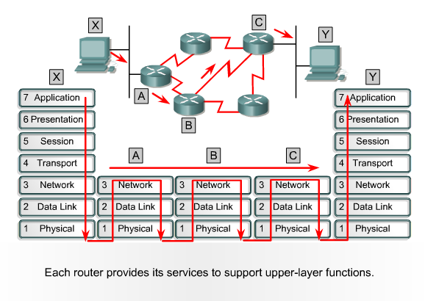
Inter-networking
The network layer is the same across all physical networks (such as Token-Ring and Ethernet).
Thus, if two physically different networks have to communicate, the packets that arrive at the Data Link Layer of the node which connects these two physically different networks, would be stripped of their headers and passed to the Network Layer.
The network layer would then pass this data to the Data Link Layer of the other physical network.

Slide 8
Congestion Control
If the incoming rate of the packets arriving at any router is more than the outgoing rate, then congestion is said to occur.
Congestion may be caused by many factors.
If suddenly, packets begin arriving on many input lines and all need the same output line, then a queue will build up.
If there is insufficient memory to hold all of them, packets will be lost. But even if routers have an infinite amount of memory, congestion gets worse, because by the time packets reach to the front of the queue, they have already timed out (repeatedly), and duplicates have been sent.
All these packets are dutifully forwarded to the next router, increasing the load all the way to the destination.
Another reason for congestion are slow processors. If the router's CPUs are slow at performing the bookkeeping tasks required of them, queues can build up, even though there is excess line capacity. Similarly, low-bandwidth lines can also cause congestion.

Slide 9
Logical addressing

Slide 10
IPv4 Address
An IPv4 address is a 32-bit address that uniquely and universally defines the connection of a device (for example, a computer or a router) to the Internet.
An IPv4 address is 32 bits long.
The IPv4 addresses are unique and universal.
The address space of IPv4 is 2³² or 4,294,967,296.

Slide 11
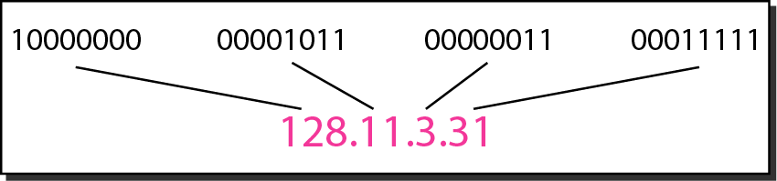
Dotted-decimal notation and binary notation for an IPv4 address

Slide 12
Network Classification
Large Networks : 8-bit network address and 24-bit host address. There are approximately 16 million hosts per network and a maximum of 126 ( 2^7 - 2 ) Class A networks can be defined.
The calculation requires that 2 be subtracted because 0.0.0.0 is reserved for use as the default route and 127.0.0.0 be reserved for the loop back function. Moreover each Class A network can support a maximum of 16,777,214 (2^24 - 2) hosts per network. The host calculation requires that 2 be subtracted because all 0's are reserved to identify the network itself and all 1s are reserved for broadcast addresses. The reserved numbers may not be assigned to individual hosts.
Medium Networks : 16-bit network address and 16-bit host address. There are approximately 65000 hosts per network and a maximum of 16,384 (2^14) Class B networks can be defined with up to (2^16-2) hosts per network.
Small networks : 24-bit network address and 8-bit host address. There are approximately 250 hosts per network.

Slide 13
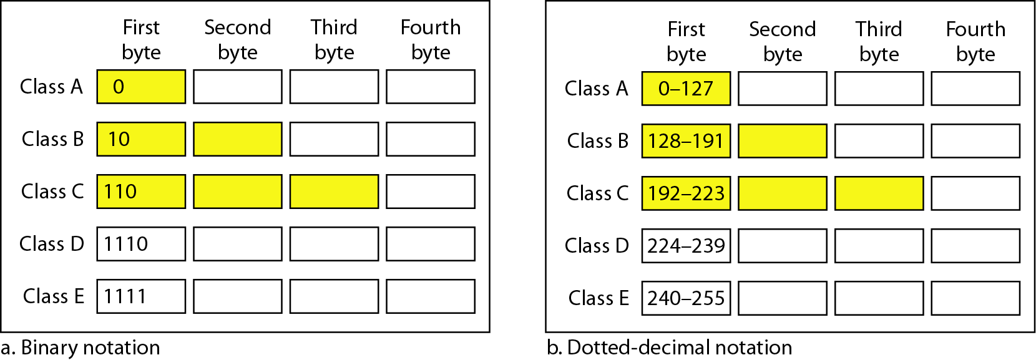
Classful addressing
In classful addressing, the address space is divided into five classes: A, B, C, D, and E

Slide 14
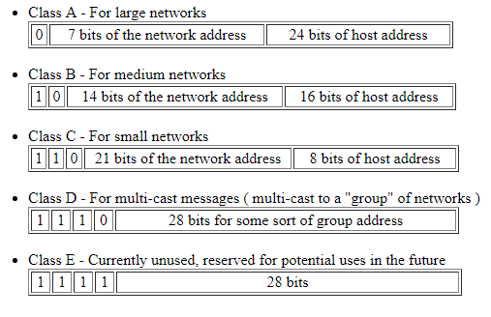

Slide 15
Number of blocks and block size in classful IPv4 addressing

Slide 16
You might think that Large and Medium networks are sort of a waste as few corporations/organizations are large enough to have 65000 different hosts.
By the way, there are very few corporations in the world with even close to 65000 employees, and even in these corporations it is highly unlikely that each employee has his/her own computer connected to the network.
Well, if you think so, you're right. This decision seems to have been a mistake

Slide 17
In classful addressing, a large part of the available addresses were wasted.
Default masks for classful addressing
Classful addressing, which is almost obsolete, is replaced with classless addressing.

Slide 18
Classless Internet addressing
In the early 1990s, the Internet moved away from a classful address space to a classless address space.
In other words, the number of bits used for the network portion of an IP address became variable instead of fixed. (The network portion of classful IP addresses is fixed.)

Slide 19
Special Addresses
Broadcast Addresses…they are of two types :
Limited Broadcast : It consists of all 1's, i.e., the address is 255.255.255.255 . It is used only on the LAN, and not for any external network.
Directed Broadcast : It consists of the network number + all other bits as 1's. It reaches the router corresponding to the network number, and from there it broadcasts to all the nodes in the network. This method is a major security problem, and is not used anymore. So now if we find that all the bits are 1 in the host no. field, then the packet is simply dropped. Therefore, now we can only do broadcast in our own network using Limited Broadcast.

Slide 20
Special Addresses
Network ID = 0
It means we are referring to this network and for local broadcast we make the host ID zero.
Host ID = 0
This is used to refer to the entire network in the routing table.
Loop-back Address
Here we have addresses of the type 127.x.y.z It goes down way upto the IP layer and comes back to the application layer on the same host. This is used to test network applications before they are used commercially.

Slide 21
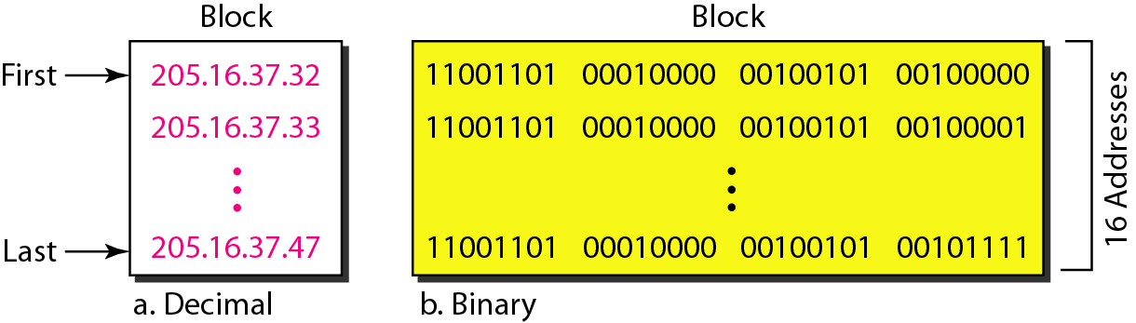
Small business that needs 16 addresses
We can see that the restrictions are applied to this block. The addresses are contiguous. The number of addresses is a power of 2 (16 = 2⁴), and the first address is divisible by 16. The first address, when converted to a decimal number, is 3,440,387,360, which when divided by 16 results in 215,024,210.

Slide 22
Mask
In IPv4 addressing, a block of addresses can be defined as x.y.z.t /n in which x.y.z.t defines one of the addresses and the /n defines the mask.
The first address in the block can be found by setting the rightmost 32 − n bits to 0s.
The last address in the block can be found by setting the rightmost 32 − n bits to 1s.

Slide 23
First address
A block of addresses is granted to a small organization. We know that one of the addresses is 205.16.37.39/28. What is the first address in the block?
Solution
The binary representation of the given address is
11001101 00010000 00100101 00100111
If we set 32−28 rightmost bits to 0, we get
11001101 00010000 00100101 0010000
or 205.16.37.32.

Slide 24
Last address
Find the last address for the block in 205.16.37.39/28.
Solution
The binary representation of the given address is
11001101 00010000 00100101 00100111
If we set 32 − 28 rightmost bits to 1, we get
11001101 00010000 00100101 00101111
or
205.16.37.47

Slide 25
The number of addresses in the block can be found by using the formula 2^{32−n}
The value of n is 28, which means that number of addresses is 2^ (32−28) or 16.

Slide 26
Another way to find the first address, the last address, and the number of addresses is to represent the mask as a 32-bit binary (or 8-digit hexadecimal) number. This is particularly useful when we are writing a program to find these pieces of information. In previous example the /28 can be represented as
11111111 11111111 11111111 11110000
(twenty-eight 1s and four 0s).
Find
a. The first address
b. The last address
c. The number of addresses.

Slide 27
Solution
The first address can be found by ANDing the given addresses with the mask. ANDing here is done bit by bit. The result of ANDing 2 bits is 1 if both bits are 1s; the result is 0 otherwise.

Slide 28
The last address can be found by ORing the given addresses with the complement of the mask. ORing here is done bit by bit. The result of ORing 2 bits is 0 if both bits are 0s; the result is 1 otherwise. The complement of a number is found by changing each 1 to 0 and each 0 to 1.

Slide 29
The number of addresses can be found by complementing the mask, interpreting it as a decimal number, and adding 1 to it.

Slide 30
A network configuration for the block 205.16.37.32/28

Slide 31
The first address in a block is normally not assigned to any device; it is used as the network address that represents the organization to the rest of the world.

Slide 32
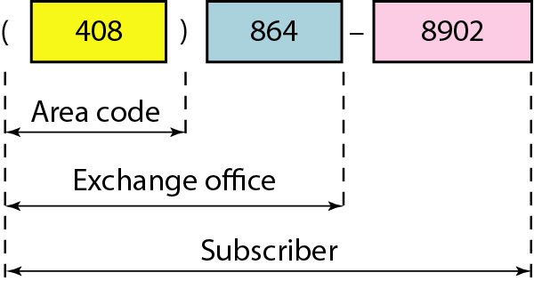
Two levels of hierarchy in an IPv4 address

Slide 33
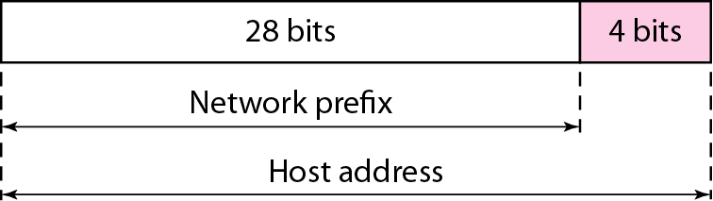
A frame in a character-oriented protocol

Slide 34
Each address in the block can be considered as a two-level hierarchical structure:
the leftmost n bits (prefix) define the network;
the rightmost 32 − n bits define the host.

Slide 35
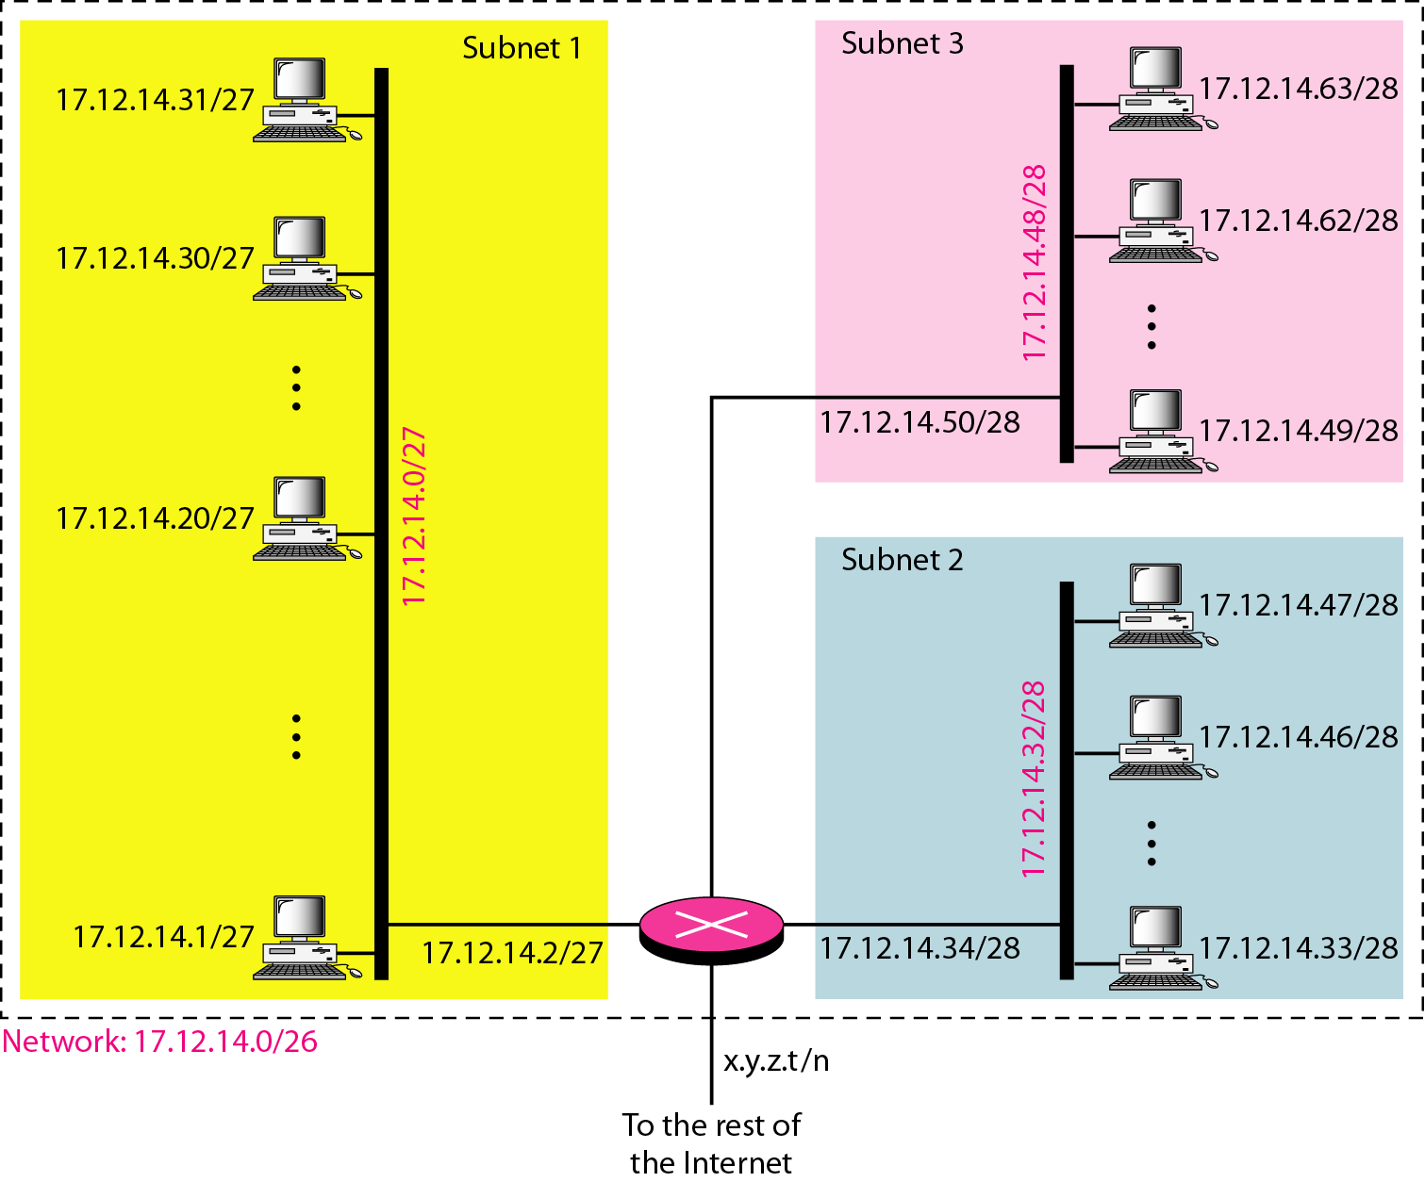
Configuration and addresses in a subnetted network

Slide 36
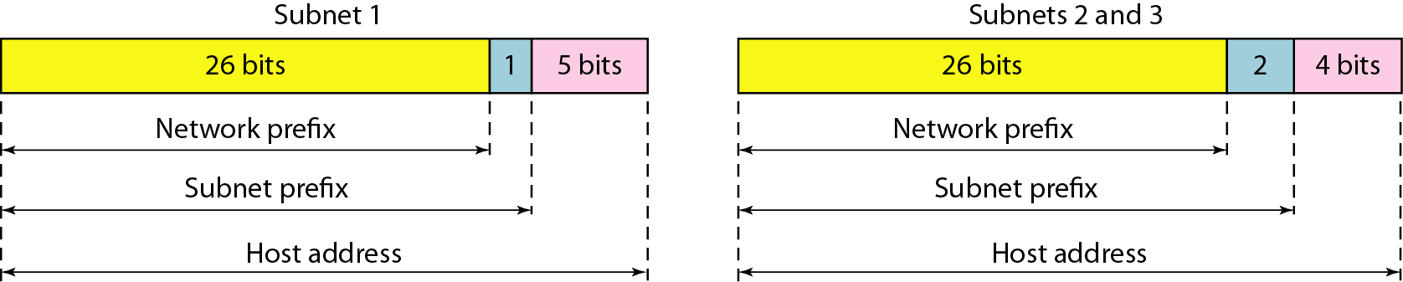
Three-level hierarchy in an IPv4 address

Slide 37
Problem
An ISP is granted a block of addresses starting with 190.100.0.0/16 (65,536 addresses). The ISP needs to distribute these addresses to three groups of customers as follows:
a. The first group has 64 customers; each needs 256 addresses.
b. The second group has 128 customers; each needs 128 addresses.
c. The third group has 128 customers; each needs 64 addresses.
Design the subblocks and find out how many addresses are still available after these allocations.

Slide 38
Group 1
For this group, each customer needs 256 addresses. This means that 8 (log2 256) bits are needed to define each host. The prefix length is then 32 − 8 = 24. The addresses are

Slide 39
Group 2
For this group, each customer needs 128 addresses. This means that 7 (log2 128) bits are needed to define each host. The prefix length is then 32 − 7 = 25. The addresses are

Slide 40
Group 3
For this group, each customer needs 64 addresses. This means that 6 (log₂64) bits are needed to each host. The prefix length is then 32 − 6 = 26. The addresses are
Number of granted addresses to the ISP: 65,536
Number of allocated addresses by the ISP: 40,960
Number of available addresses: 24,576

Slide 41
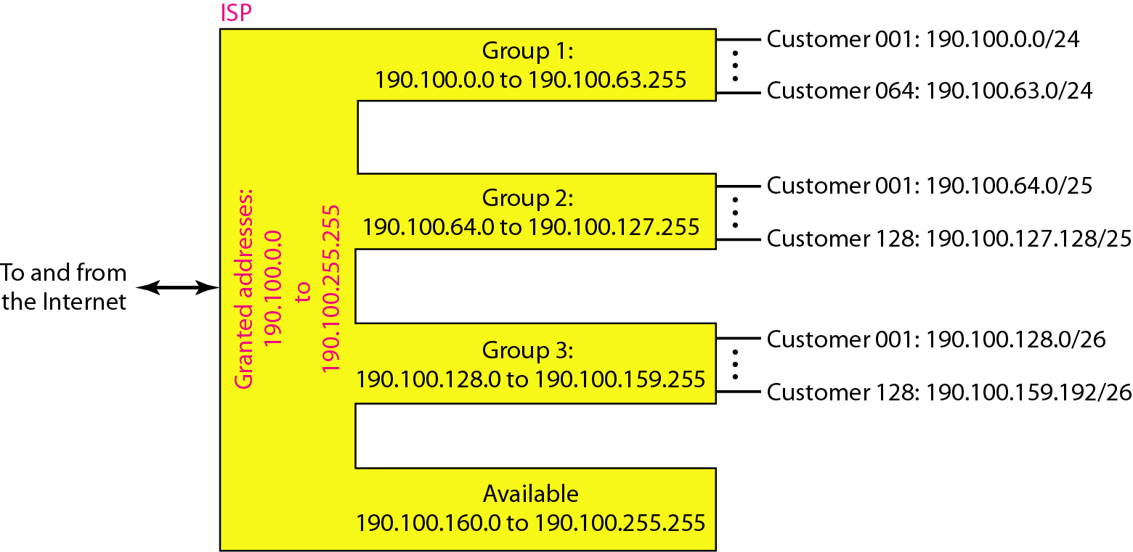

Slide 42
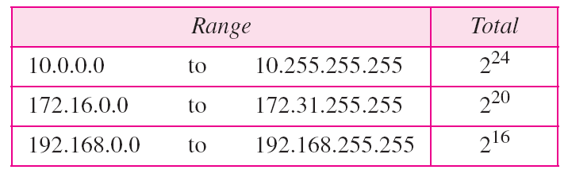
Addresses for private networks

Slide 43
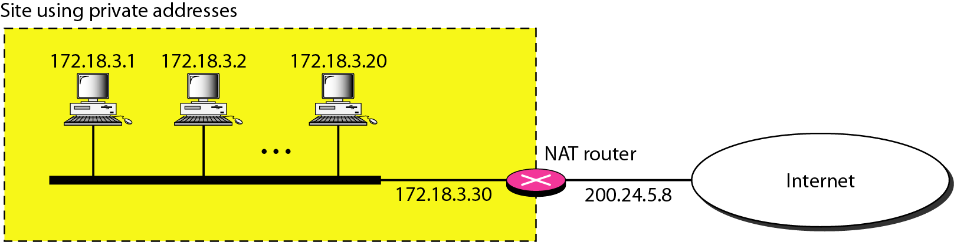
A NAT implementation

Slide 44
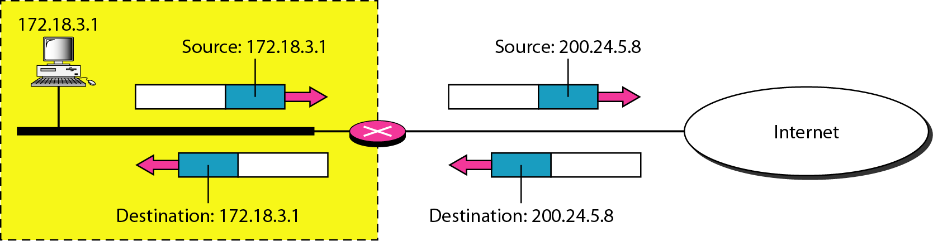
Addresses in a NAT

Slide 45
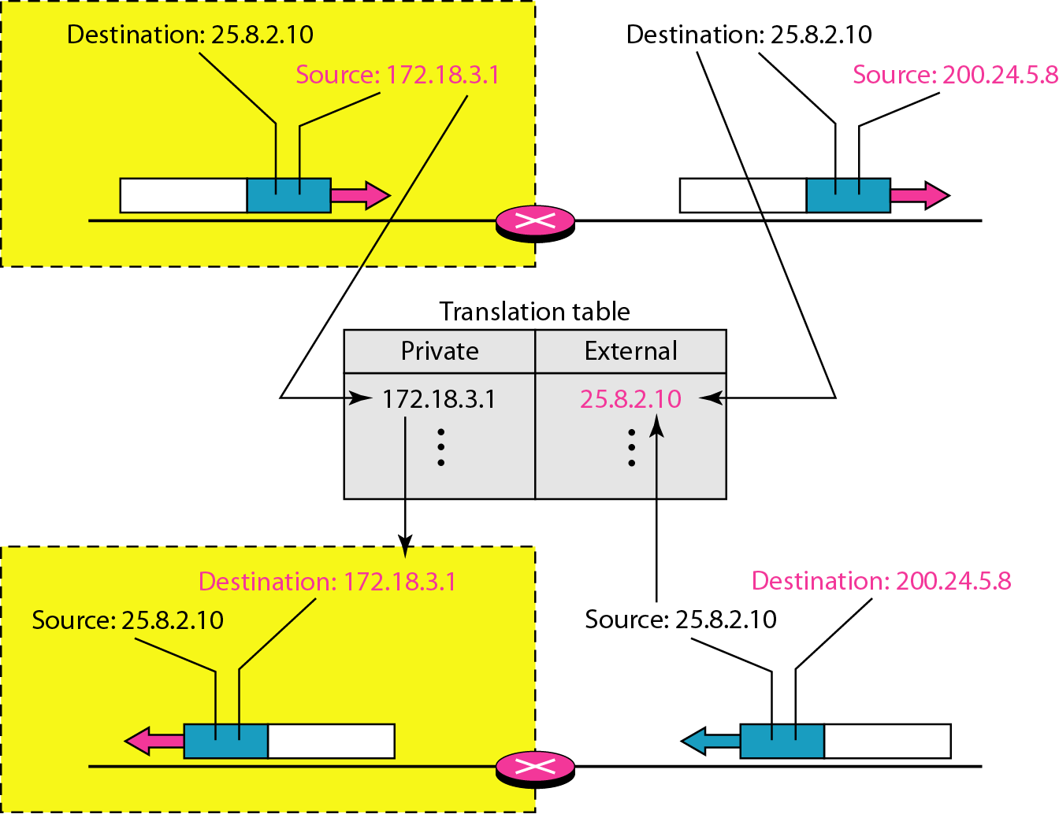
NAT address translation

Slide 46
Five-column translation table

Slide 47
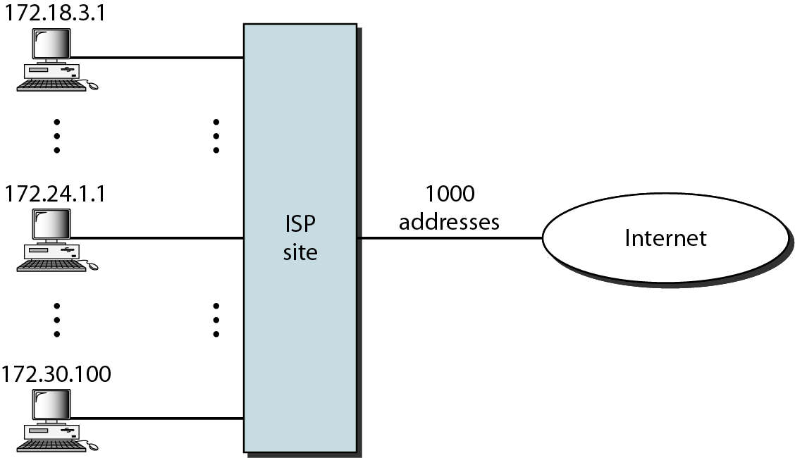
An ISP and NAT

Slide 48
IPv6 Addresses
Despite all short-term solutions, address depletion is still a long-term problem for the Internet. This and other problems in the IP protocol itself have been the motivation for IPv6.

Slide 49
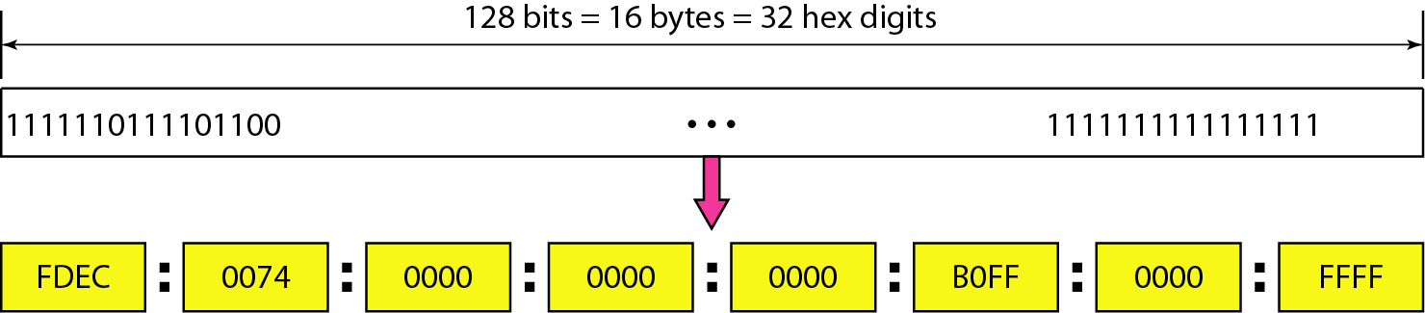
An IPv6 address is 128 bits long.

Slide 50
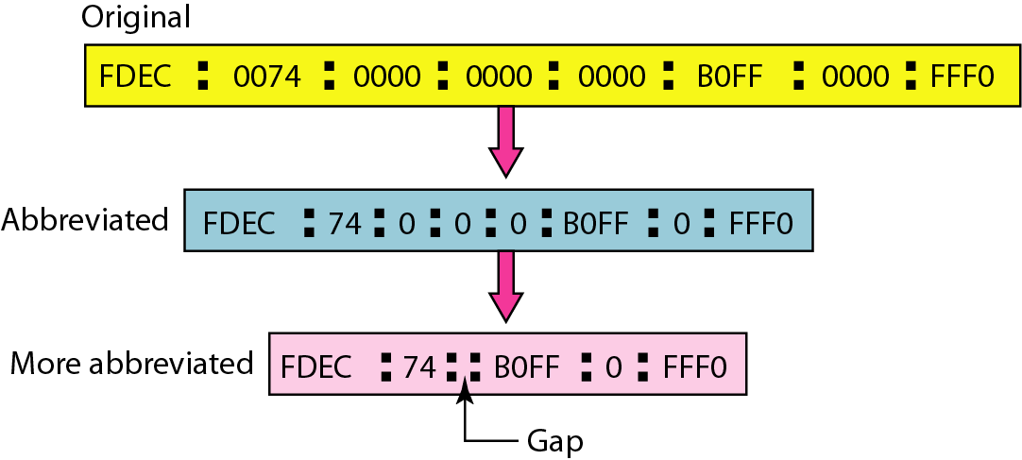
Abbreviated IPv6 addresses

